Slide 1
Digital Image Processing
Lecture 1-Introduction

Slide 2
Objective
To provide the knowledge on Images and its representation, types and manipulations.

Slide 3
Learning Outcomes
At the end of the course, the students will be able to
describe Image representation
perform Basic Operation on images
perform Enhancement in images using filters
perform Extraction and Processing the Region of Interest (ROI)
Notes:
1. Filters – improve quality or remove irrelevant features from image. Smoothing the image, sharpening, edge enhancement

Slide 4
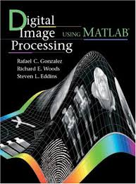
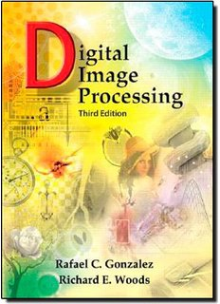
Reference Book
Rafael C. Gonzalez & Richard E. Woods , 2009, “Digital Image Processing using Matlab”, 2nd Edition, Gatesmark Publishing,
Rafael C. Gonzalez & Richard E. Woods , 2007 , “Digital Image Processing”, 3rd Edition, Prentice Hall

Slide 5
Outline
Digital image?
Digital image processing?
History of digital image processing
Examples of digital image processing
Key stages

Slide 6
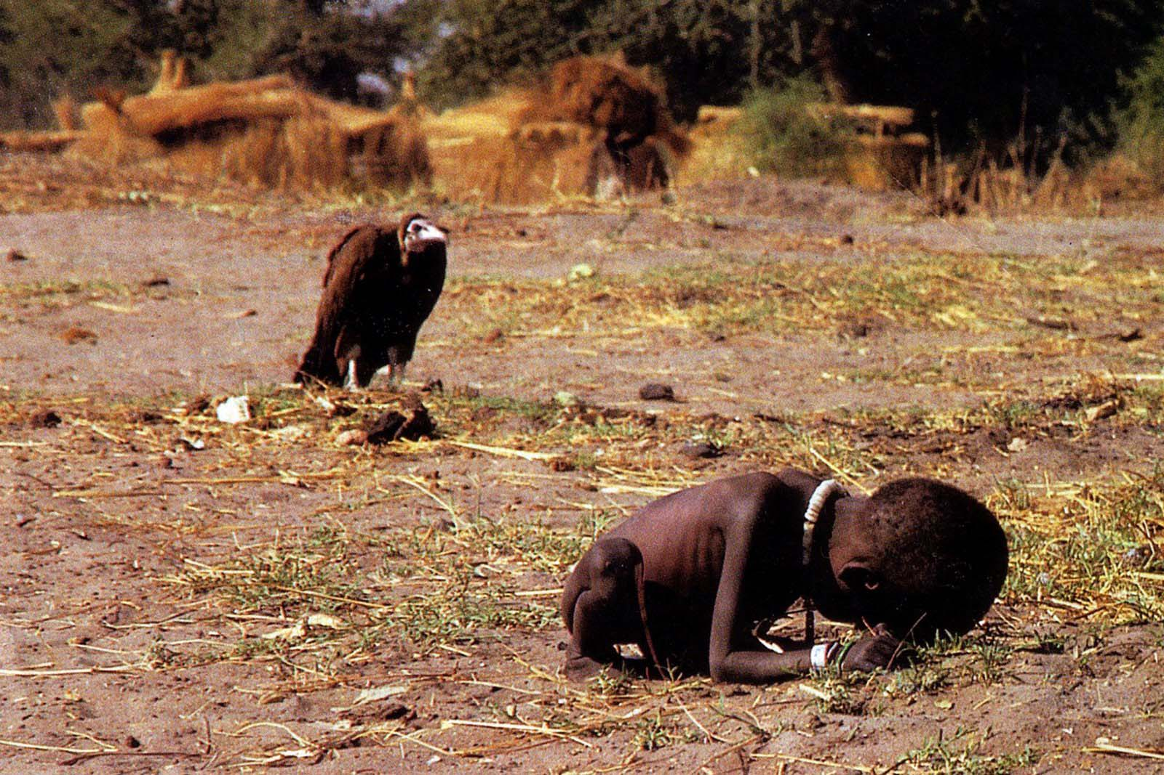
“One picture is worth more than ten thousand words” Anonymous
www.google.com
Notes:
Kevin Carter 1993 Pulitzer Award – Little girl and the vulture
Malnutrition Poverty Starving kinds -> feeding center
U.N. feeding center and survived the incident.

Slide 7

Digital Image
A digital image is a representation of a two-dimensional image as a finite set of digital values, called picture elements or pixels
Images taken from Gonzalez & Woods, Digital Image Processing (2002)
Notes:
The values should be finite then we can call it as digital
MATLAB - techniques are there to extract the pixel values as matrix
Imaging system consist of light collector (lens), light receptor (sensors) and light transformers (pixels)
Wavelengths of waves (Photons) decides the color
Angle and amount of light is decided by the surface of object
Travel through one or more lens -> bent/refracted the light waves and then they meet sensor
Sensor is the focal plane like a grid includes pic elements converts photons to electrons
Lens are round - Aspect ratio -> hor and vert ratio of the sensor. It’s decided without affecting the edges of the object

Slide 8

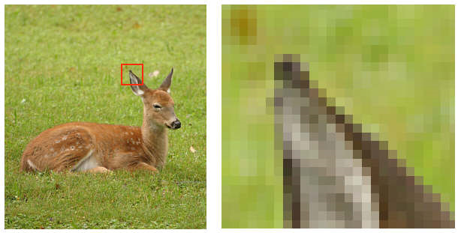
Digital Image
Pixel values typically represent gray levels, colours, opacities etc.
Digitization implies that a digital image is an approximation of a real scene
1 pixel
Images taken from Gonzalez & Woods, Digital Image Processing (2002)
Notes:
Opacity – the level of transparency, opacity decreases transparency increases but brightness decreases
Digitization – once the scene is captured using a imaging system it’ll be converted as a digital image. In the sense, every pixel point will be represented using finite number, altogether a matrix.

Slide 9
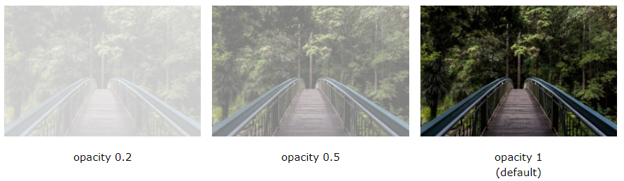
Transparent vs Opacity

Slide 10
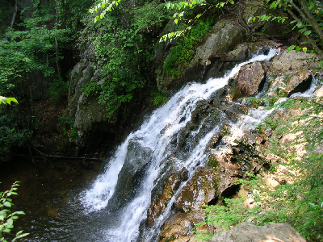
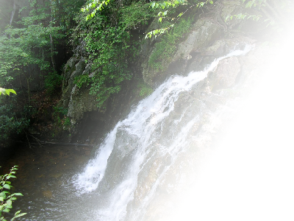
Digital Image
Common image formats include:
1 sample per point (B&W or Grayscale)
3 samples per point (RGB)
4 samples per point (Red, Green, Blue, and “Alpha”, a.k.a. Opacity)
Images taken from Gonzalez & Woods, Digital Image Processing (2002)
Notes:
Samples per point – number of values a pixel can take

Slide 11
What is Image Processing
Processing of a Two dimensional picture in a digital computer
Digital image processing focuses on two major tasks
Improvement of pictorial information for human interpretation
Processing of image data for storage, transmission and representation for autonomous machine perception
Notes:
Autonomous – self-directed
Face detection in phones

Slide 12
What is Digital Image Processing
The continuum from image processing to computer vision can be broken up into low-, mid- and high-level processes
Low Level Process
Low Level Process
Mid Level Process
Mid Level Process
High Level Process
Input: Image Output: Image
Examples: Noise removal, image sharpening
Input: Image Output: Image
Examples: Noise removal, image sharpening
Input: Image Output: Attributes
Examples: Object recognition, segmentation
Input: Image Output: Attributes
Examples: Object recognition, segmentation
Input: Attributes Output: Understanding
Examples: Scene understanding, autonomous navigation

Slide 13
History of DIP
Early 1920s
Transfer images between Submarines
Mid to late 1920s
Improved Images
1964
Computers used to improve the quality of images of the moon taken by the Ranger 7 probe
1979:
Sir Godfrey N. Hounsfield & Prof. Allan M. Cormack share the Nobel Prize in medicine for the invention of tomography (CAT)
Notes:
One of the first applications of digital images was in the newspaper industry,
when pictures were first sent by submarine cable (cable links laid on the seabed or bottom of freshwater bodies) between London and
New York. Transport all the way from atlantic in 1 week reduced to 3 hours.
Talk about black and white TV – its actually gray
5 to 15 gray levels to represent an image (in mid 1920s) in bartline system
The first computers powerful enough to carry out meaningful image processing tasks appeared in the early 1960s.
displaying a representation of a cross section through a human body or other solid object using X-rays or ultrasound.
CAT scan or CT scan – computed (axial) tomography

Slide 14
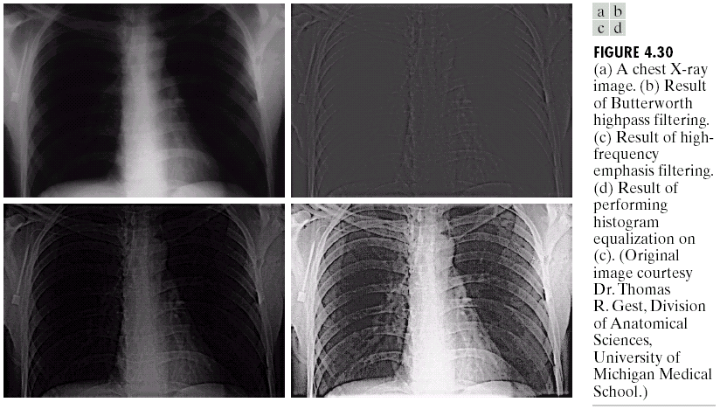
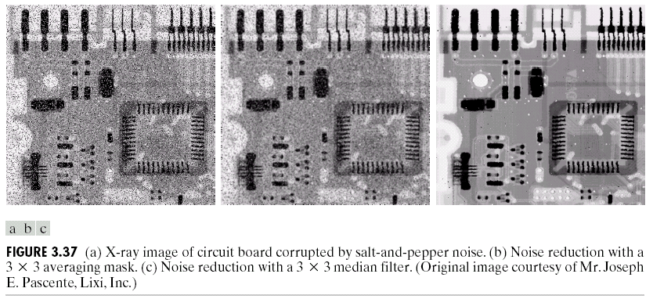
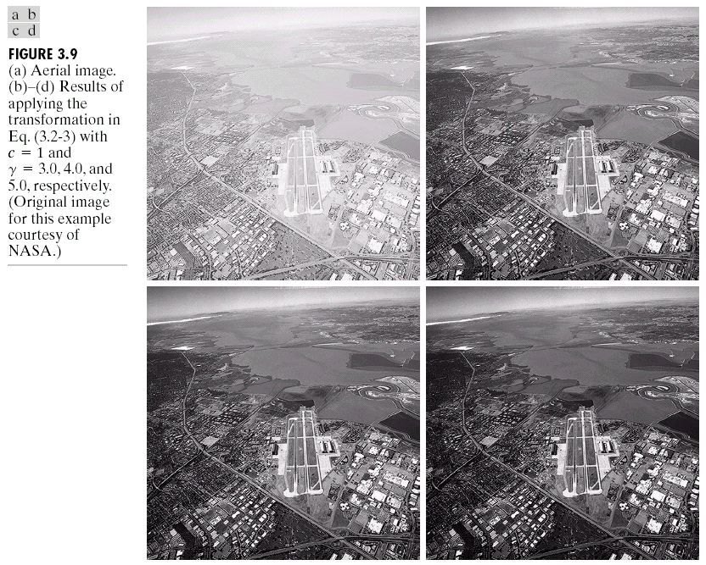
Image Enhancement
Images taken from Gonzalez & Woods, Digital Image Processing (2002)
Notes:
humans, who are limited to the visual band of the electromagnetic (EM) spectrum
imaging machines cover almost the entire EM spectrum, ranging from gamma to radio waves.
Example for x ray images, x ray one of oldest technique of EM for imaging purposes

Slide 15
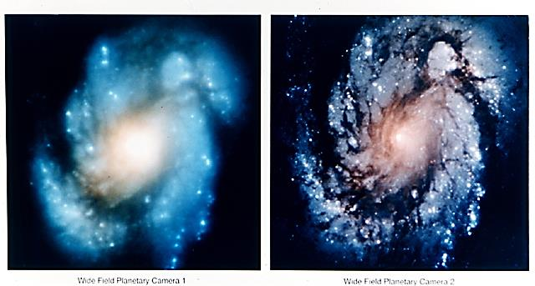
Hubble Images
Images taken from Gonzalez & Woods, Digital Image Processing (2002)
Notes:
Hubble space telescope – named after an astronomer

Slide 16
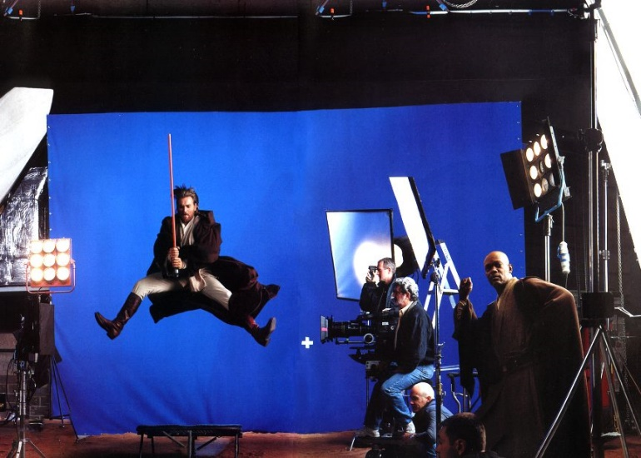
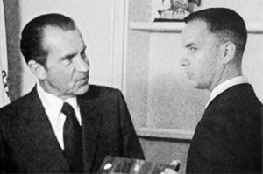
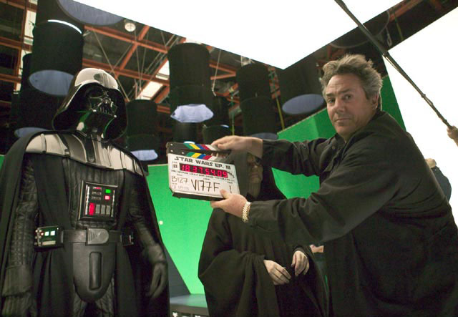
Artistic images
www.google.com

Slide 17
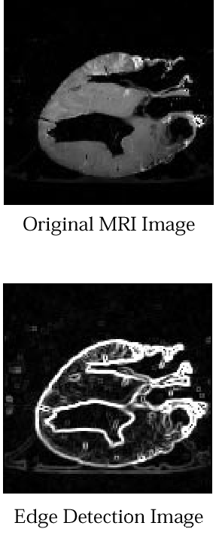
Medical Image Processing
Original MRI Image of a Dog Heart
Edge Detection Image
Images taken from Gonzalez & Woods, Digital Image Processing (2002))

Slide 18
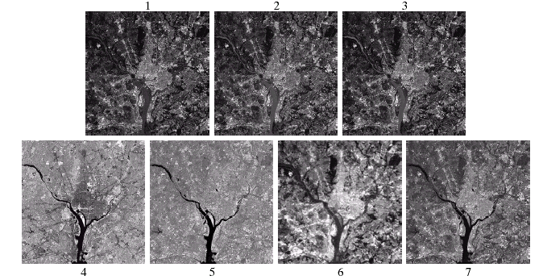
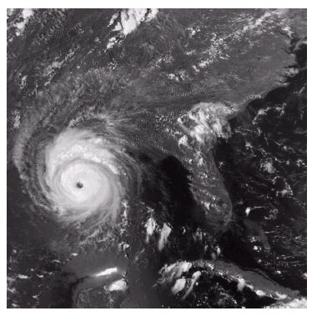
GIS & Remote Sensing
Images taken from Gonzalez & Woods, Digital Image Processing (2002)
Notes:
Geographic info. System
Katrina hurricane captured in 2005
Satellite image to analyze the populated area

Slide 19
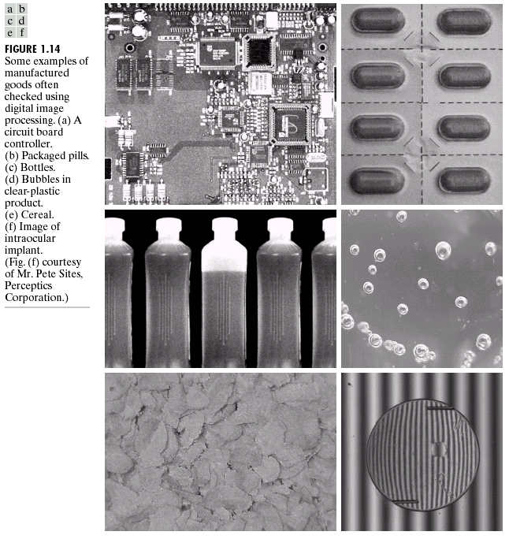
Industry
Images taken from Gonzalez & Woods, Digital Image Processing (2002)
Notes:
tablet
Air bubbles in plastic product
intraocular implant.
Logic board
Bottle
Cereal

Slide 20
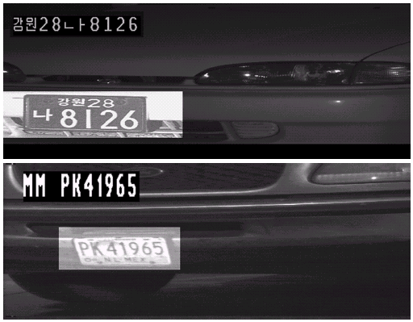
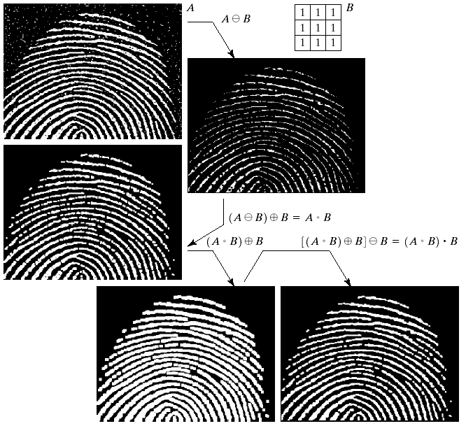
Law and Crime
Images taken from Gonzalez & Woods, Digital Image Processing (2002)

Slide 21
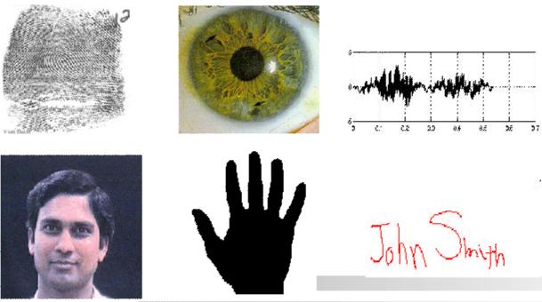
Biometrics
Notes:
Processing biological data

Slide 22
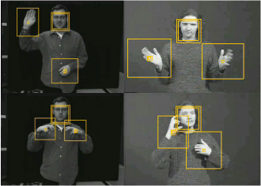
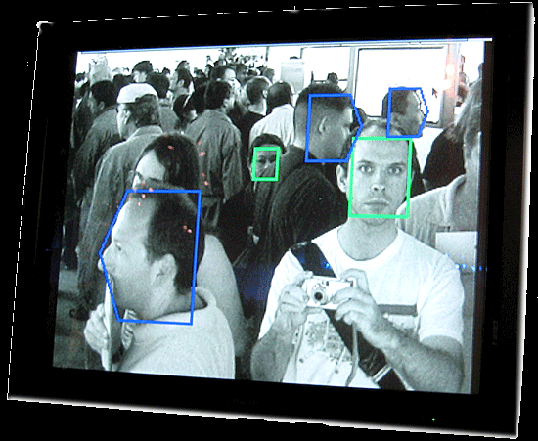
Human Computer Interaction
www.google.com
Notes:
Movement of the eye control the cursor on the screen – still at research level

Slide 23
Key Stages
Image Restoration
Morphological Processing
Image Enhancement
Segmentation
Image Acquisition
Object Recognition
Representation & Description
Problem Domain
Colour Image Processing
Image Compression

Slide 24
Image Acquisition
Images taken from Gonzalez & Woods, Digital Image Processing (2002)

Slide 25
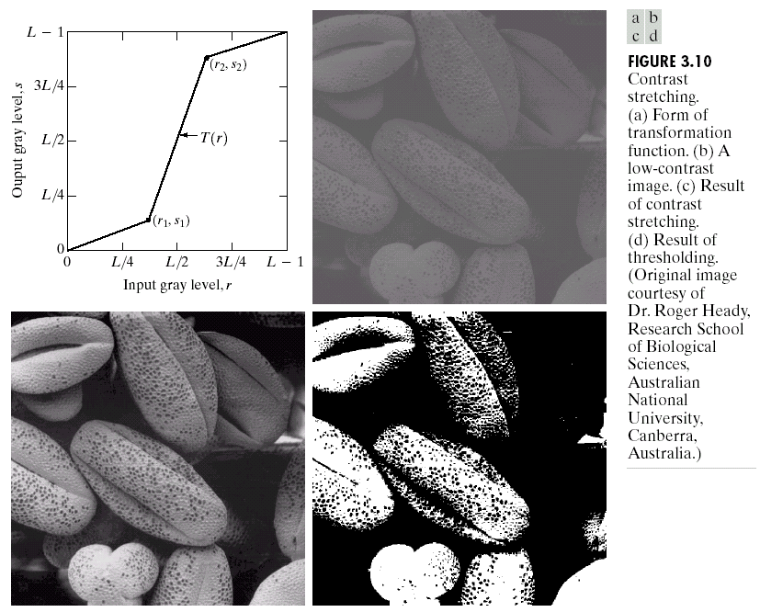
Image Enhancement
Images taken from Gonzalez & Woods, Digital Image Processing (2002)
Notes:
To enhance the quality of the images for interpretation based on the area.
Used to manipulate the image so that it’s suitable for further processing in a specific area.
visually appealing, interesting, and relatively simple to understand deviate

Slide 26
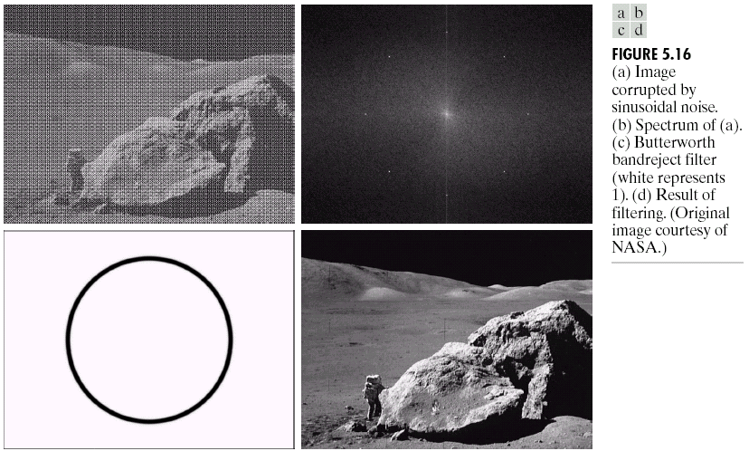
Image Restoration
Images taken from Gonzalez & Woods, Digital Image Processing (2002)
Notes:
Improve visual appearance.
Enhancement is subjective – based on the human emotion and perception
Restoration – objective – doesn’t affected by the human perception. To overcome the image degradation there are several mathematical restoration techniques
Degradation comes in many forms such as motion blur, noise, and camera misfocus.
restoration often refers to the case where one attempts to mathematically invert the degradation

Slide 27
Morphological Processing
Images taken from Gonzalez & Woods, Digital Image Processing (2002)
Notes:
Tools to extract image components
boundaries

Slide 28
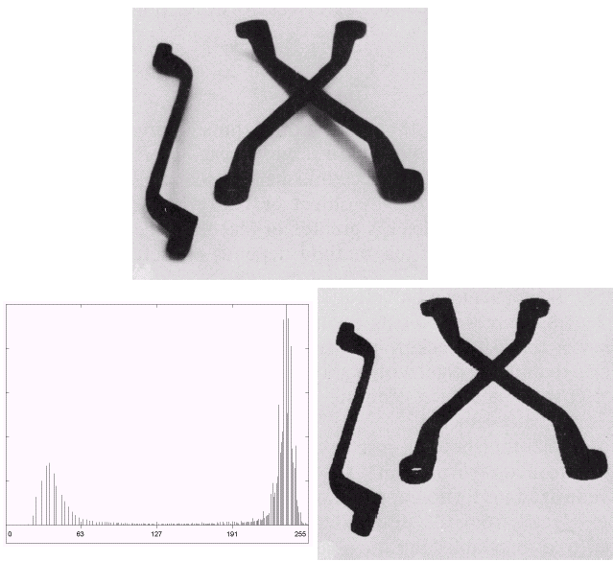
Segmentation
Images taken from Gonzalez & Woods, Digital Image Processing (2002)
Notes:
Partition the image into certain no. of objects

Slide 29
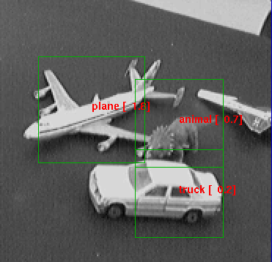
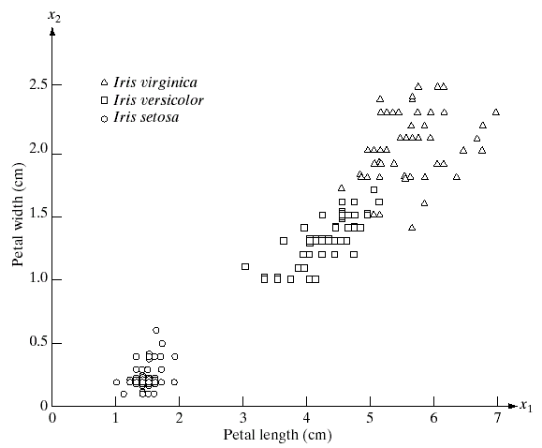
Object Recognition
www.google.com
Notes:
By considering various features we can do the extraction

Slide 30
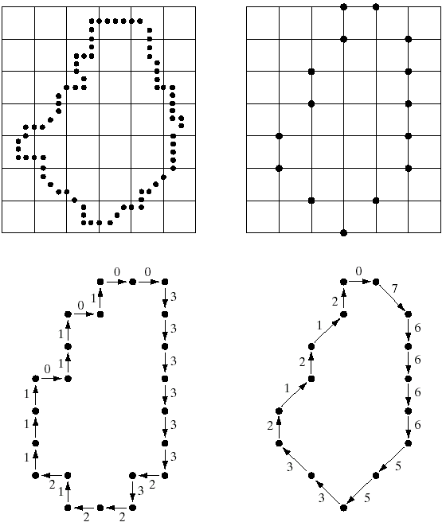
Representation & Description
Images taken from Gonzalez & Woods, Digital Image Processing (2002)
Notes:
Always follow Output of image segmentation, choosing a representation is only the part of solution for transforming raw data into processed data.
After the segmentation need to decide whether to represent as a boundary or the entire region for processing
Border – shape n size
Entire region – texture, color

Slide 31
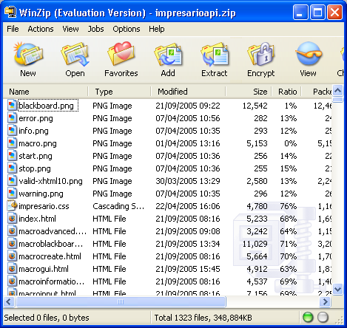
Image Compression
www.google.com
Notes:
Reduce the storage required to store the image.
We all refer it by the means of extension
deals with techniques for reducing the
storage required to save an image, or the bandwidth required to transmit it. Although
storage technology has improved significantly over the past decade, the
same cannot be said for transmission capacity

Slide 32
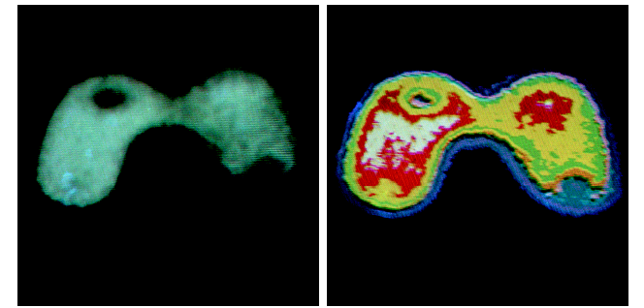
Colour Image Processing
Images taken from Gonzalez & Woods, Digital Image Processing (2002)
Notes:
Extract features from image based on color

Slide 33
Summary
What is an Image
What is DIP
Application of DIP
Key Stages
Example for Each Stages

